Slide 1
Simulating Water Freezing Using Canonical Ensembles Method (NVT)
Numerical Algorithms Applied to Computational Quantum Chemistry
By: Dakota Turk & Matt Waseem

Slide 2
Key Focus Areas
Slides 1 - 3
Background
An accurate water simulation model is critical in many industries and chemical processes where water is a primary solvent (Energy, Pharmaceuticals etc..).
Slides 4 - 9
Numerical Modeling Algorithms
System Models (NPT, NVT), Structural Models (Simple Point Charge SPC, Transferable Intermolecular Potential TIP3P, SPC/E, TIP5P etc..).
Slides 10 - 12
Software Implementation
Software stack (frontend development, backend, Docker, CMake, GUI).
Slides 13 - 14
Simulation & Future Developments
Brief Simulation showcase, ongoing improvements and performance considerations.
Notes:
Key Focus Areas
> Why Simulate Water ??
> Existing Physical Chemistry Research
> Modeling Considerations
> Unique Properties of water to consider such as the dielectric characteristics, phase changes.
> Software implementation (front end , backend, communication between the two systems, GUI )
> Simulation Showcase, Future Developments and Performance considerations.

Slide 3
Applications of Water Simulation Models
Pharmaceutical
Research
Material Science
Nuclear Energy
R&D focused on solvation effects, and drug efficacy.
Materials hydration, Polymers & Nano material.
Thermodynamics properties under various conditions.
Simulations help predict binding affinities (small molecule and ligand binding)
Water interaction at the molecular level with polymers.
Thermodynamic behavior of water under extreme conditions
Stabilizing drug receptor complexes
Prediction of ligand binding sites
Polymer structure flexibility
Enhanced Material design
Thermal studies of materials in presence of water
Water studies in supercritical temperatures
water density and entropy changes
Radiation induced changes
Notes:
> Why simulate Water
Unique Properties of water makes it play vital role in different industries.
Industrial impact in chemical process
Drug discovery and R&D role
etc
Water simulation models are critical in industries like Energy and Pharmaceuticals
Accurate models help predict molecular interactions and behaviors
Essential for understanding solvent effects and chemical processes
References: Waters role in drug discovery
https://link.springer.com/article/10.1134/S1810232823010113
Waters role in material science
https://pubs.rsc.org/en/content/articlelanding/2009/fd/b805531a?
Energy Sector extreme conditions water behavior and modeling simulations https://arxiv.org/abs/2108.07837

Slide 4
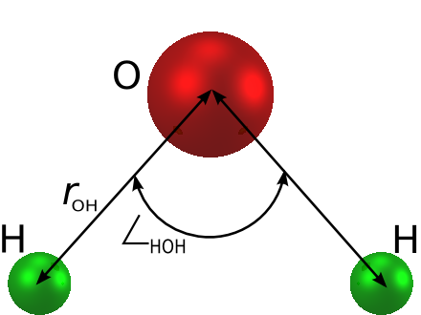
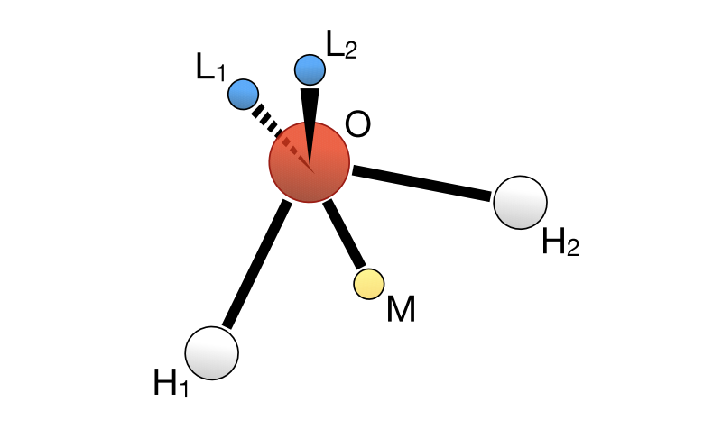
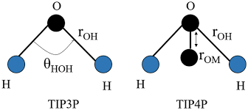
Existing Structural Models
01
Simple Point Charge
A rigid 3 - point model
Fixed atomic charges
Other variations include SPC/E
02
Transferable Intermolecular Potential
Three point model optimized for MD
Used for bi-molecular studies
Other versions TIP3P, TIP4P, TIP5P
03
Polarizable Water Model
Adjusts dipoles based on local environment
To model water’s dielectric property
Other versions MB-Pol, POL3
Notes:
There are dozens of structure modeling techniques
SPC, SPC/E and its main use and limitations,
TIP3P, TIP4P, TIP5P its main use and limitations,
MB-POL, POL its main use and limitations

Slide 5
Canonical Ensembles vs Ensemble Methods
Canonical Ensemble Method (NVT)
Represents a system with a fixed number of particles (N), Volume (V), and temperature (T)
Used for simulation requiring constant environmental conditions
Applied i molecular dynamics and to investigate temperature dependent phenomenon such as crystallization
Ensemble Methods
Broader term simulations that under various conditions (microcanonical (NVE) and grand canonical ensembles
Microcanonical is fixed energy, volume and number of particles (NVE)
Used in Energy conservation studies
Adsorption and phase
Notes:
there also system modeling consideration for the simulation which are
Canonical Ensemble versus Ensemble approaches, NPT versus NVT

Slide 6
Model water under constant thermodynamic conditions with gradual cooling and hydrogen bonding interactions using a hybrid SPC model with NVT system conditions.
Our Objective:
Notes:
Canonical Ensemble versus Ensemble approaches, NPT versus NVT
Develop a hybrid SPC water model
Use NVT system conditions
Model water under constant thermodynamic conditions
Simulate gradual cooling
Analyze hydrogen bonding interactions

Slide 7
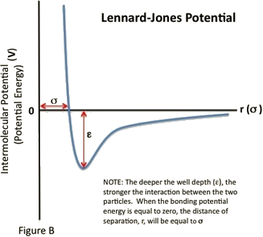
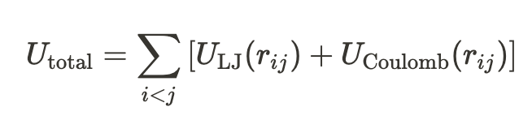
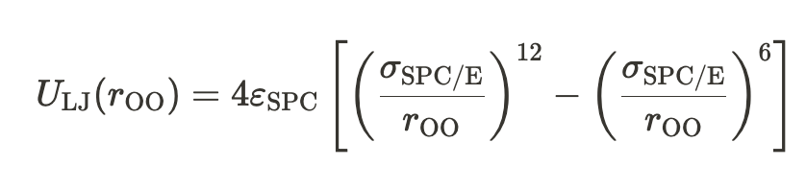
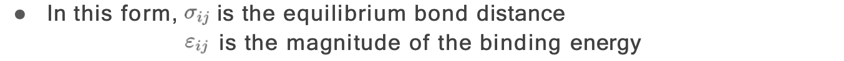
Methods: Lennard Jones Potential
Consider a simple point charge model interaction
Spherically symmetric atoms
i.e. no directional chemical bonds
intermolecular interactions
12-6 Lennard-Jones Potential
Reference: Chem279 Lecture 2 slide 9 - 14
Izadi, S., & Onufriev, A. V. (2016, August 21). Accuracy limit of rigid 3-point water models. The Journal of chemical physics. https://pmc.ncbi.nlm.nih.gov/articles/PMC4991989/
Notes:
Lennard-Jones Potential
Models intermolecular interactions
Considers spherically symmetric atoms
Uses 12-6 potential function

Slide 8
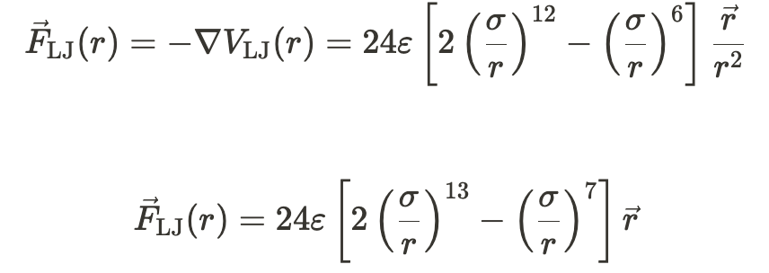
Methods: LJ Force Calculations
Derivative of LJ potential to get the forces at the different time steps
Reference: Chem279 Lecture 2 slide 9 - 14
Notes:
Forces that is applied on opposing oxygen atoms
Calculate translation and rotational forces
Analyze molecular interactions at atomic level

Slide 9
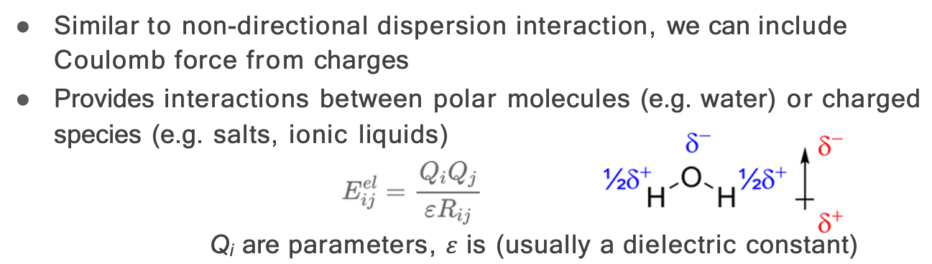
Methods: Dipole Moment and Coulombic Interactions
The coulombic interactions well be broken down into more specific forces
Reference: Chem279 Lecture 2 slide 9 - 14
Notes:
Dipole Moment and Coulombic Interactions
Calculate translation and rotational forces
Analyze molecular interactions at atomic level and average them to simplify the calculation.
Note cut off was done at LJ potential

Slide 10
Methods: Coulombic Interactions cont.
In order to apply these forces we need to break them down:
Translation forces
Rotational forces
See interactive Geogebra page below.
Consider the following, H1 on molecule 1 and H1 on molecule 2
Force Vector
Translational
Force Vector
Torque
https://www.geogebra.org/3d/na9arbmv

Slide 11
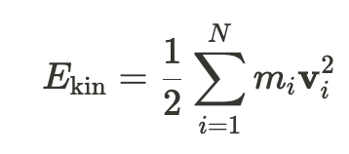
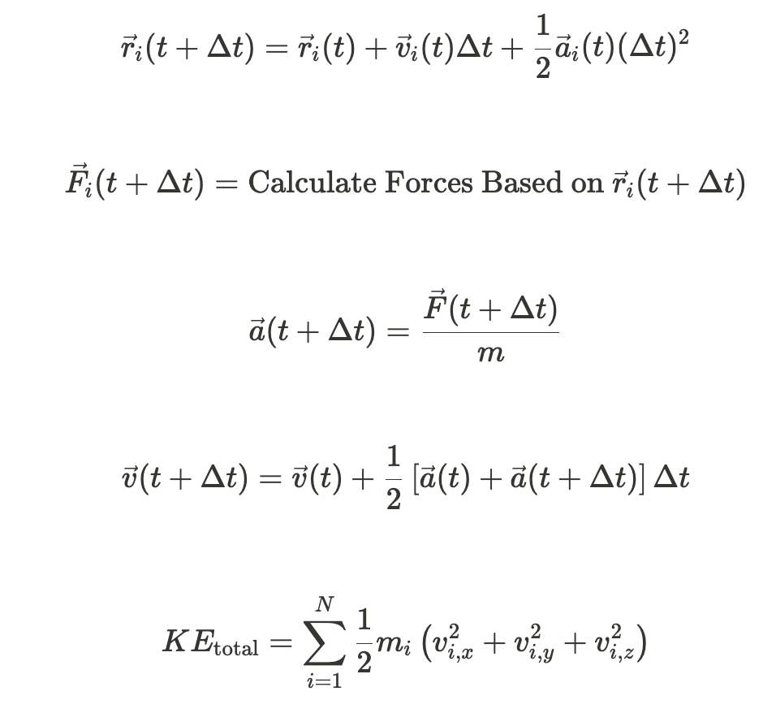
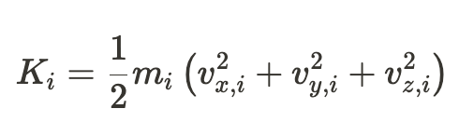
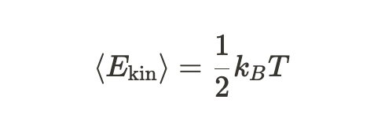
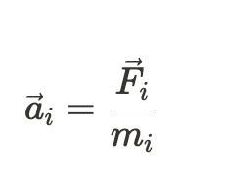
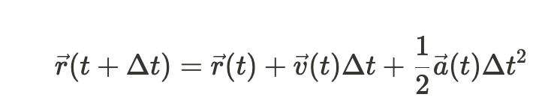
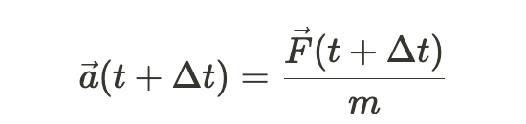
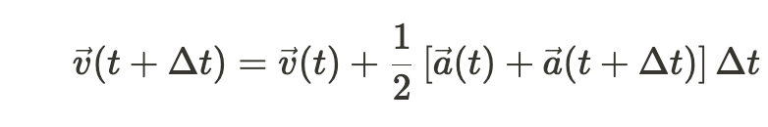
Kinetic Energy and Velocity Calculation
Kinetic Energy
Velocity-Verlet Algorithm

Slide 12





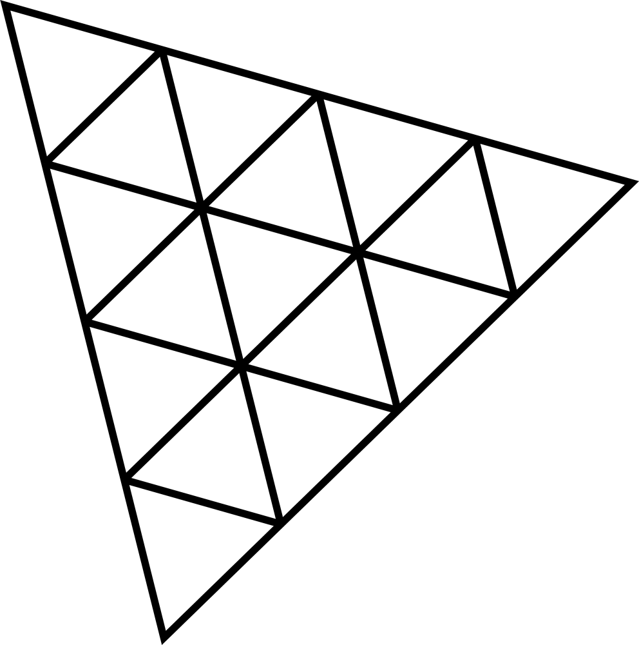


Software Stack
Frontend
Visualization
Our Backend
(Simulation Implementation)
Our Server
“Serve” - Middle Man
NodeAPI Call
Web Request
Host or Clients Machine’s Web Browser
dat.GUI
Open Port
NodeAPI Return
Web Response
Compiled into a NodeJS API Module
three js
Containerized for ease of deployment
Notes:
Dakota will present

Slide 13
Backend Implementation
Developed in all C++
Compiled into a custom Node API module
Runs simple simulation stack:
Declare initial variables
Calculate initial conditions
Run simulation step
“Zero” forces
Calculate forces
Update position
Apply boundary conditions
Each Simulation Step
Calculate Forces
- LJ Forces
- Coulombic Forces
Boundary Conditions
Update Positions
- Position is out of bounds, reflect velocity and reduce temperature
- Applies velocity and force to position.
- Applies force to velocity
Notes:
Dakota will present

Slide 14
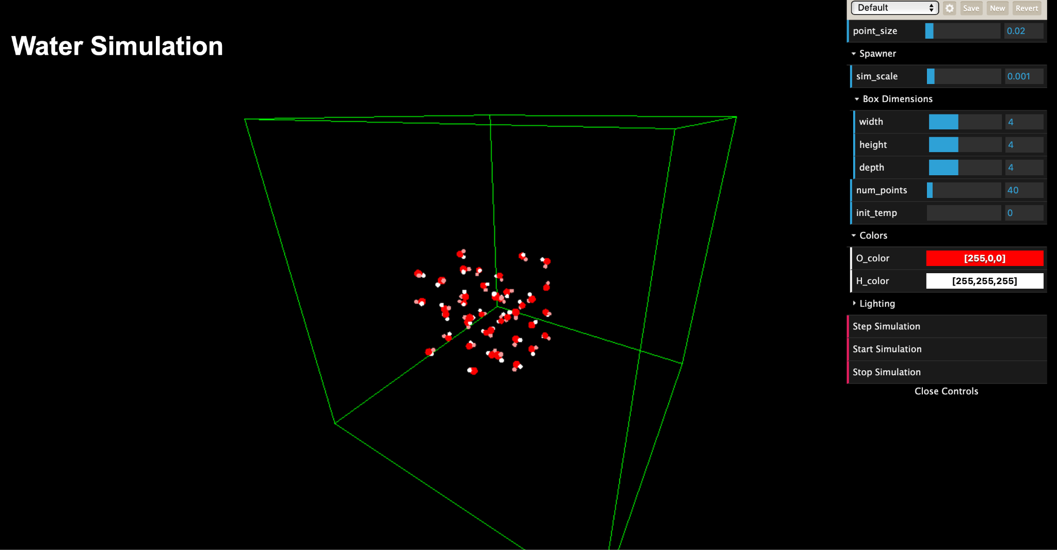
Front End Implementation
All implementation was designed to allow as many machines to run and visualize the simulation as possible.
To achieve this, we decided to use the web browser for visual. They have many more examples as well as resources to get 3D visualizations working vs. something like C++.
HTML5
Javascript
ThreeJS
dat.GUI
Web requests
WebGL (GLSL)
Notes:
Dakota will present

Slide 15
Simulation Showcase
Notes:
Dakota will present and/or showcase directly

Slide 16
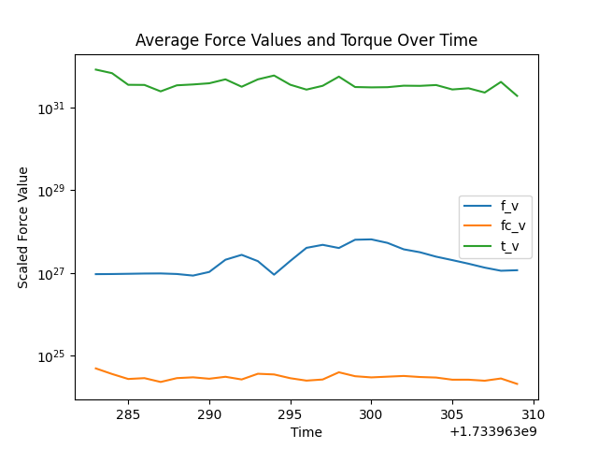
Results
Average LJ forces at each time step (f_v)
Average of Coulombic Forces (fc_v)
Average torque forces
directly correlated to dipole calculations
Notes:
Dakota will present

Slide 17

Discussions: Struggle Points
Particles being initialized un-realistically close together
Causing LJ forces to “explode” the particles in a cramped space
Units, Units, Units! ! !
Determination of simulation type (NVT, NPT, NVE…)
“Ooh shiny” syndrome
We started all of our work on wanting to recreate another simulation someone else ran, this led to many initial misunderstandings of the equations and procedure for our code.
We all do it, no shame
Sebastians videos https://www.youtube.com/watch?v=rSKMYc1CQHE&t=954s
Notes:
Dakota will present

Slide 18
Discussions: Future Development
Correctly implementing Coulombic forces (being worked on).
Static dynamics for correct rotational forces experienced.
Lock down all initial parameters.
Prevent user from changing them during run time.
Correct Initial bounds calculations on the UI side.
Reset simulation button.
Large-scale modularization.
Others implement their desired calculations.
Changing of molecules and atomic parameters.
Combine/merge energy and force calculations.
Implement other properties of water
thermal expansion coefficient, isobaric heat capacity, dielectric constant
Monte-Carlo Simulation for bond angle prediction to achieve optimal bonds.
An error check mechanism to ensure all units match!!
Notes:
We can both talk about and present

Slide 19
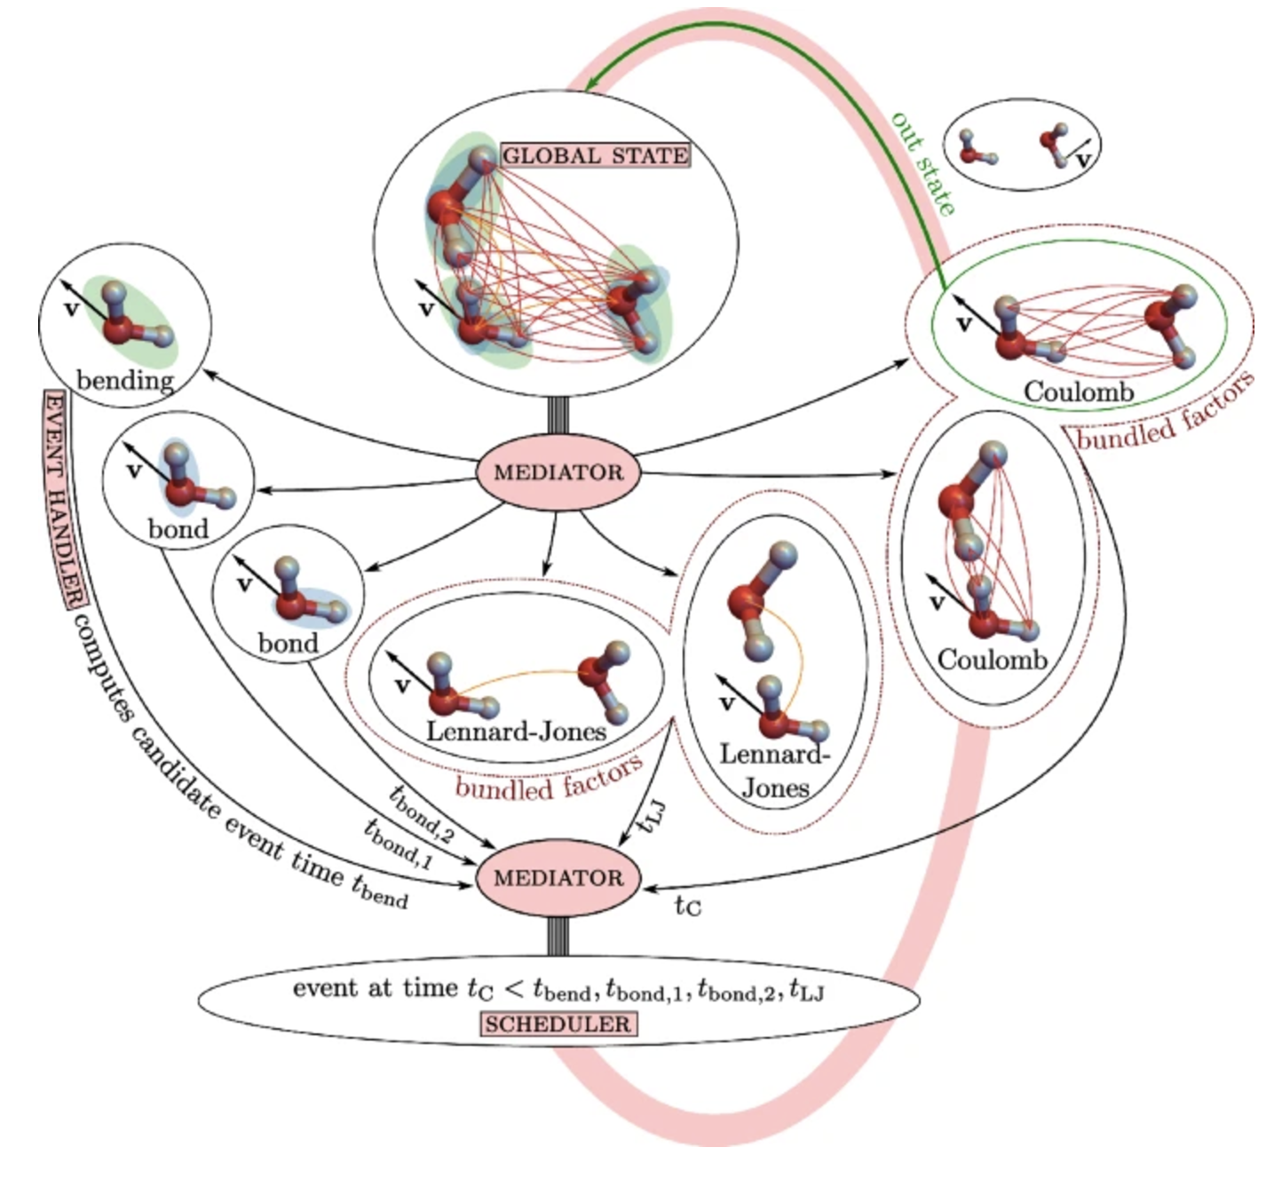
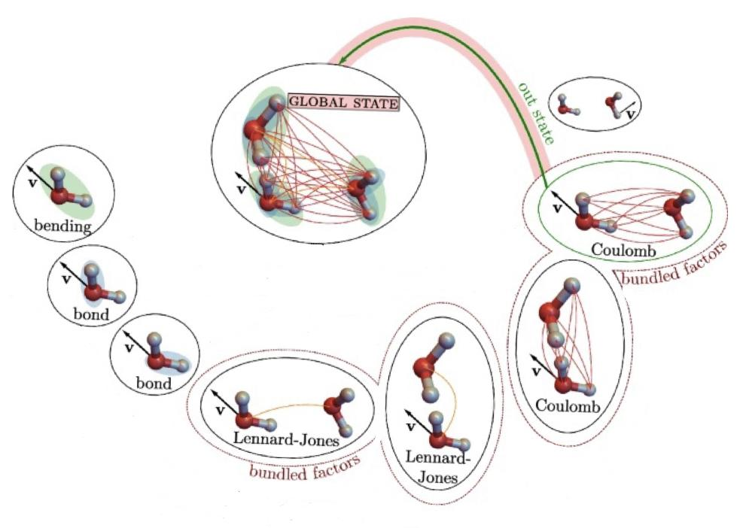
Hydrogen - Oxygen Bond Angle Optimization
Bond angle change performed with a monte carlo algorithm
If the bond angle results low potential energy accept else continue.
Höllmer, P., Maggs, A. C., & Krauth, W. (2024, July 16). Fast, approximation-free molecular simulation of the SPC/FW water model using non-reversible Markov chains. Nature News. https://www.nature.com/articles/s41598-024-66172-0
Notes:
Use Monte Carlo algorithm for bond angle optimization
Evaluate potential energy of bond configurations
Accept configurations with lower potential energy
Aim to achieve optimal molecular structure
something similar to what they did in this paper
Höllmer, P., Maggs, A. C., & Krauth, W. (2024, July 16). Fast, approximation-free molecular simulation of the SPC/FW water model using non-reversible Markov chains. Nature News. https://www.nature.com/articles/s41598-024-66172-0

Slide 20
Thank you!
Live Simulation Showcase and Q&A’s
Höllmer, P., Maggs, A. C., & Krauth, W. (2024, July 16). Fast, approximation-free molecular simulation of the SPC/FW water model using non-reversible Markov chains. Nature News. https://www.nature.com/articles/s41598-024-66172-0

Slide 21
References
Höllmer, P., Maggs, A. C., & Krauth, W. (2024, July 16). Fast, approximation-free molecular simulation of the SPC/FW water model using non-reversible Markov chains. Nature News. https://www.nature.com/articles/s41598-024-66172-0
Izadi, S., & Onufriev, A. V. (2016, August 21). Accuracy limit of rigid 3-point water models. The Journal of chemical physics. https://pmc.ncbi.nlm.nih.gov/articles/PMC4991989/
Martin.chaplin@btinternet.com, M. C. (n.d.). Water models. https://water.lsbu.ac.uk/water/water_models.html
For detailed references please visit Notion page dedicated to this project: https://www.notion.so/Molecular-Dynamic-Simulation-of-Water-130778e8c4238072b858de53ea4cbc5b
Notes:
harmonics for the bond angle
treat the system at a 3 bond system isoceles triangle

Slide 22
Key Takeaways
Water simulation models are crucial for scientific research
Complex computational methods enable molecular-level understanding
Ongoing research continues to improve simulation techniques (ML-approaches)
Interdisciplinary applications across pharmaceuticals, materials science, and energy
Höllmer, P., Maggs, A. C., & Krauth, W. (2024, July 16). Fast, approximation-free molecular simulation of the SPC/FW water model using non-reversible Markov chains. Nature News. https://www.nature.com/articles/s41598-024-66172-0
Notes:
Use Monte Carlo algorithm for bond angle optimization
Evaluate potential energy of bond configurations
Accept configurations with lower potential energy
Aim to achieve optimal molecular structure
something similar to what they did in this paper
Höllmer, P., Maggs, A. C., & Krauth, W. (2024, July 16). Fast, approximation-free molecular simulation of the SPC/FW water model using non-reversible Markov chains. Nature News. https://www.nature.com/articles/s41598-024-66172-0

